Slide 1
Perfect Storm? War, Stagflation, Hunger
Jomo Kwame Sundaram
Vienna
20 October 2022
Thanks to Dr Werner Raza for very helpful suggestions.
But responsibility lies with Jomo alone.

Slide 2
Malnutrition challenges
Malnutrition > food security – challenges:
macronutrients (hunger)
Hunger estimates narrow, conservative
micronutrient [minerals, vitamins, trace elements] deficiencies (hidden hunger)
diet-related non-communicable diseases
Overweight, obesity
Malnutrition widespread, costly
Notes:
Malnutrition remains widespread:
Since 1990–92, the estimated number of undernourished people in developing countries has declined from 980 million to 852 million and the prevalence of undernourishment has declined from 23% to 15%.
Between 1990 and 2011, the prevalence of stunting in developing countries declined by an estimated 16.6 %age points, from 44.6% to 28%. There are 160 million stunted children in developing countries today, compared with 248 million in 1990.
Inadequate energy intake is only one dimension of malnutrition. About 2 billion people suffer from micronutrient deficiencies. Vitamin A
deficiency is the leading cause of blindness in children. In 2007, 163 million children under five in developing countries were estimated to be vitamin A deficient, with a prevalence of about 31 percent, down from approximately 36 percent in 1990. Iron-deficiency anaemia negatively
affects the cognitive development of children, pregnancy outcomes, maternal mortality and the work capacity of adults. Globally about 47% of children under five suffer from anaemia – about half of that is due to iron deficiency. About 40% of women, over 500 million, are affected by anaemia. Iodine deficiency impairs the mental function of 18 million children born each year. Overall, iodine deficiency is falling. Estimates indicate that goitre prevalence (indicative of an extended period of deprivation, assessed in adults and/ or children) in developing countries fell from around 16 percent to 13 percent between 1995–2000 and 2001–07. Low urinary iodine (indicative of a current iodine deficiency) fell from around 37 percent to 33 percent
The global prevalence of combined overweight and obesity has risen in all regions, with prevalence among adults increasing from 24 percent to 34 percent between 1980 and 2008. The prevalence of obesity has increased even faster, doubling from 6 percent to 12 percent. Today about 1.4 billion people are overweight, 500 million of these are obese.
Undernutrition is more severe in rural areas. In 82 of the 95 developing countries for which data are available, the prevalence of child underweight is higher in rural than in urban areas. The lower prevalence of undernutrition among children in urban areas appears to be the result of the cumulative effect of a series of more favourable socio-economic conditions, which in turn lead to a healthier environment and better feeding and caring practices for children.
The social and economic costs:
The social and economic costs of malnutrition can be quantified in different ways, although any methodology has limitations.
Disability adjusted life years (DALYs) measure the social burden of disease, or the health gap between current health status and an ideal
situation where everyone lives into old age, free of disease and disability (WHO, 2008a). One DALY represents the loss of the equivalent of one full year of “healthy” life. DALYs for a disease or injury are calculated as the sum of the years of life lost due to premature mortality (YLL) in the population and the years lost due to disability (YLD) for incident cases of the disease or injury (DALY=YLL+YLD).
Child and maternal malnutrition still imposes by far the largest nutrition-related health burden globally, with more than 166 million DALYs lost per year in 2010 compared with 94 million DALYs lost due to adult overweight and obesity. Worldwide, DALYs attributed to high BMI and related risk factors, such as diabetes and high blood pressure, have increased dramatically, while those attributed to child and maternal malnutrition have decreased.
Cost of undernutrition & micronutrient deficiencies estimated at 2 - 3 % of GDP (World Bank, 2006). Cost of underweight in five Central American countries and the Dominican Republic estimated at US$6.7 billion, ranging from 1.7 to 11.4 % of GDP (Martínez and Fernández, 2008).
Median economic cost due to anaemia estimated at 4 % of GDP for 10 developing countries, ranging from 2% in Honduras to 8% on Bangladesh (Horton and Ross, 2003).
Vitamin and mineral deficiencies estimated to represent an annual loss of 0.2 - 0.4% GDP, equivalent to US$2.5 -5 billion, in China (World Bank, 2006). Combined cost of iron-deficiency anaemia, zinc deficiency, vitamin A deficiency and iodine deficiency amounts to about 2.5% of GDP in India (Stein and Qaim, 2007).
Total output loss due to NCDs, for which overweight and obesity are a key risk factor, is estimated at US$47 trillion over the next two decades (Bloom et al, 2011).
Total cost of malnutrition may be as high as 5% of global GDP, equivalent to US$3.5 trillion or US$500 per person per year.

Slide 3
Malnutrition’s multiple faces
> 722m people undernoursished in 2020
> 2 bn suffer micronutrient deficiencies
Children: 161m. stunted, 51m. wasted, 99m. underweight
45% of 6.9 m. child deaths annually linked to malnutrition
42 m. overweight children < 5 years
2.1 bn overweight, ~700 m. adults obese

Slide 4
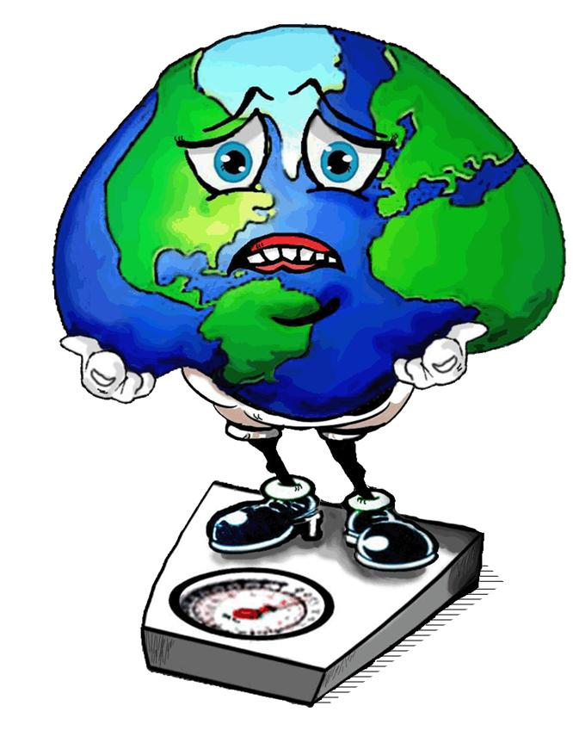
Economic costs of obesity
McKinsey Global Institute (2014)
Economic costs
Armed conflicts
$2.1 trillion
Smoking
About 1.9 ~ 2.1 billion people overweight (1/3 obese), i.e., 30% of global population
$2.1 trillion
Obesity
$2.0 trillion

Slide 5
Hidden hunger Micronutrient deficiencies
Micronutrients: vitamins, minerals, trace elements
Dietary diversity: sustainable ‘food system’ solution
Nutrition supplements: very costly solution
Some low-cost options, e.g., table salt iodization, fertilizers (soil → plant → human nutrition)

Slide 6
Diet-related non-communicable diseases
Many non-communicable diseases (NCDs), i.e., not infectious, e.g., related to smoking, occupational safety, etc.
Many food or diet-related NCDs
Now mainly associated with obesity, overweight
Also associated with excessive sugar, salt consumption
Loosely, wrongly termed ‘overnutrition’

Slide 7
Better nutrition? Why? How?
Malnutrition costs lives, money
Healthier diets need better food systems
Health, education, water, sanitation, lifestyles, etc. needed
Appropriate policies, incentives, governance
Sustainable food systems central
Without full employment, decent work, need social protection floor to realize right to food
Notes:
Malnutrition costs the world approximately US$3.5 billion (5 percent of global GDP) per year (about US$500 per person) in lost productivity and direct health care costs. About US$2.5 billion is due to undernourishment, undernutrition and micronutrient deficiencies. The rest is due to overweight and obesity. .

Slide 8
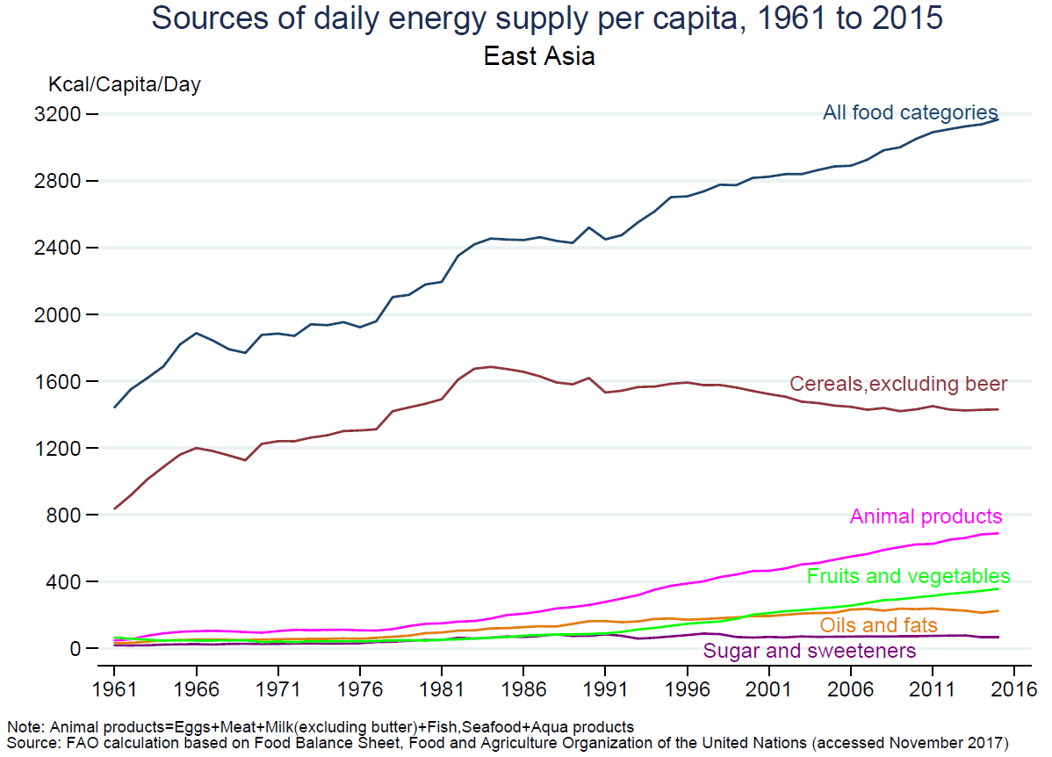
Solution: More varied, not less food

Slide 9
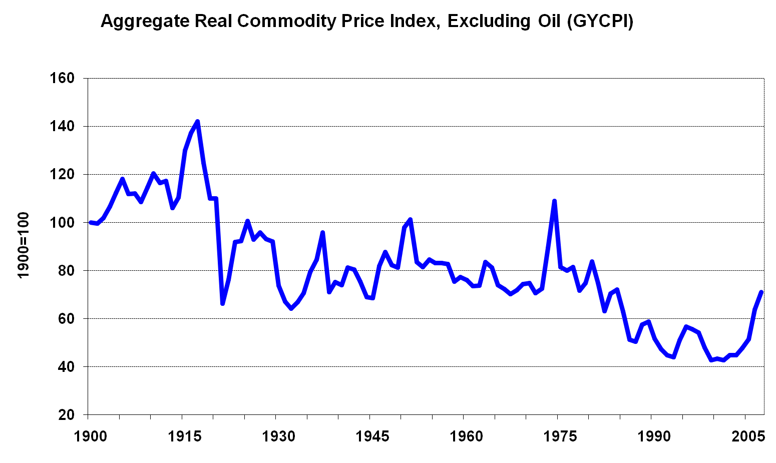
Commodity prices lower post-1970s
Source: updated Grilli and Yang dataset

Slide 10
Tropical agricultural prices, 1865-2015

Slide 11
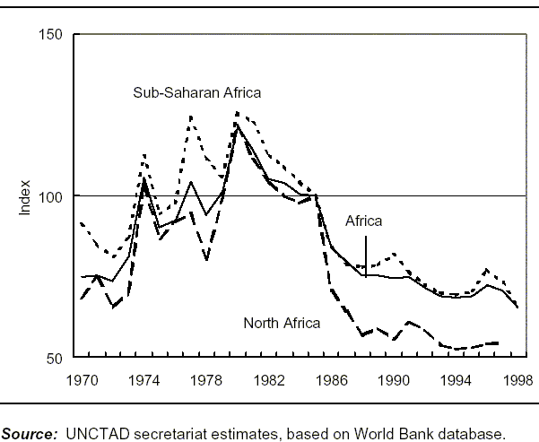
African terms of trade worse

Slide 12
Commodity terms of trade worse for most LMICs, with some levels close to 2012-14

Slide 13
Government initiatives
Many private sector initiatives, progress need government encouragement, regulation
Improve infrastructure, other efforts to reduce food losses, improve food safety
Improve farmers’ planting, harvest and post- harvest practices
Public, especially civil society campaigns to reduce food waste, malnutrition

Slide 14
Food production, supply, loss, waste
Sustainable agriculture = Agroecology? Transition?
Hunger associated with inadequate food supply
Inadequate food supply not due to inadequate food production, but means, emergencies
Food losses during production, storage, transport
Food waste in consumption, e.g., sale, preparation

Slide 15
Undernourishment
Inadequate dietary energy from macronutrients, measured as calories/joules, mainly from carbohydrates, usually cereals
Prevalence of undernourishment (%): estimated undernourished (‘hungry’) share of population
Number of undernourished: estimated undernourished population
Generally slow progress compared to poverty although poverty measures mainly consider cost of food viz income, to avoid hunger

Slide 16
Impact of Ukraine crisis on global food security
Vicious cycles of climate change, conflict, poverty, food insecurity leaving millions very vulnerable
Food production, import vulnerabilities and rigidities
Declining international solidarity
Climate-induced supply strains
Grain hoarding, commodity speculation → price crisis
Identified after 2007-8 food price crisis, but unaddressed
Careful: opportunistic and shortsighted responses to crisis
e.g., backsliding on food system reform commitments

Slide 17
Stagflation drivers
Global financial crisis → Great Recession
→ ‘unconventional’ QE + fiscal austerity
2014 commodity prices collapse
C19, war, sanctions → supply-side disruptions
Supply-side ‘cost-push’ inflation
Also: ‘global warming’ effects worse in tropics
Raising interest rates → economic stagnation
Interest rate hikes deliberate in 1980, 2022
1980 ended stagflation, but 2022 worsens it

Slide 18
Macroeconomic policy constraints
Monetary policy less effective, worse with independent central banks
Imposed fiscal requirements for stimulus, worse with independent fiscal authority
Policy -- especially fiscal – space constrained
Systemic pro-cyclicality v counter bus. cycles
Lost productive capacities due to earlier liberalization, globalization, disruptions
18

Slide 19
War, sanctions, stagflation, hunger
No to WTO waiver (vaccines, tests, treatments, PPE)
SWIFT financial payments system undermined
War sanctions → siege: deliberate supply cuts
Energy supplies to Europe disrupted
Food, fertilizer supplies cut → med.-term insecurity
Wheat, fertilizer: protracted higher food prices
Food, fertilizer for Asia, Africa → food insecurity

Slide 20
Urgent action needed
Support food importing countries, e.g., debt relief
Tackle commodity speculation,
enhance market, ownership transparency
Reduce reliance on fertilizers, pesticides,
fossil energy in food production
Improve national, regional grain reserves,
food security response systems
Diversify food production, change trade flows

Slide 21
Thank you Carpe diem
IDEAs website: www.networkideas.org
For more, you can subscribe for free at https://jomoglobaldev.substack.com/publish or visit my website www.ksjomo.org

