Slide 1

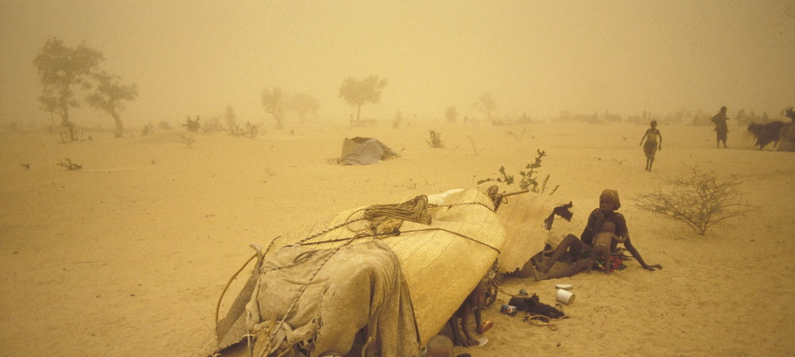
Olivia Akumu
Vienna | 25 February 2020
MIXED MIGRATION DYANMICS IN EAST AFRICA
VIDC: Fortress Europe? Current migration trends and European responses

Slide 2
MIXED MIGRATION
Mixed migration refers to cross-border movements of people including refugees fleeing persecution and conflict, victims of trafficking and people seeking better lives and opportunities. Motivated to move by a multiplicity of factors, people in mixed flows have different legal statuses as well as a variety of vulnerabilities. Although entitled to protection under international human rights law, they are exposed to multiple rights violations along their journey. Those in mixed migration flows travel along similar routes, using similar means of travel - often travelling irregularly and wholly or partially assisted by migrant smugglers.
.

Slide 3
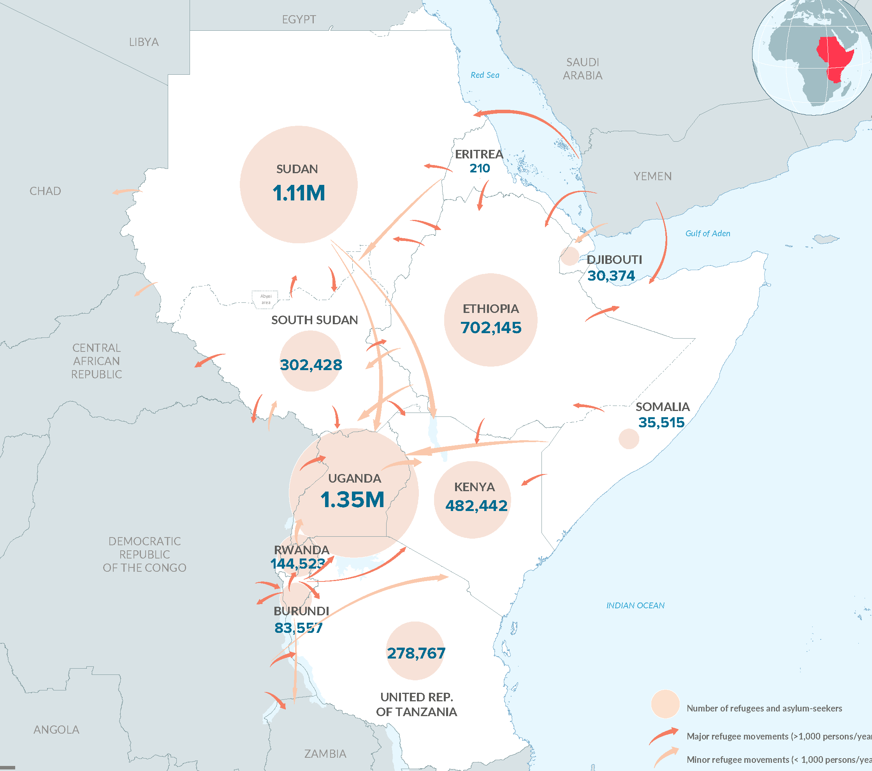
4.5
million
asylum seekers and refugees
UNHCR, Sep 2019
5.2
million
IDPs
IDMC, 2018
Notes:
59% below 18 years old
81% women and children
Countries of origin – South Sudan (2.14M), DRC (673K)

Slide 4
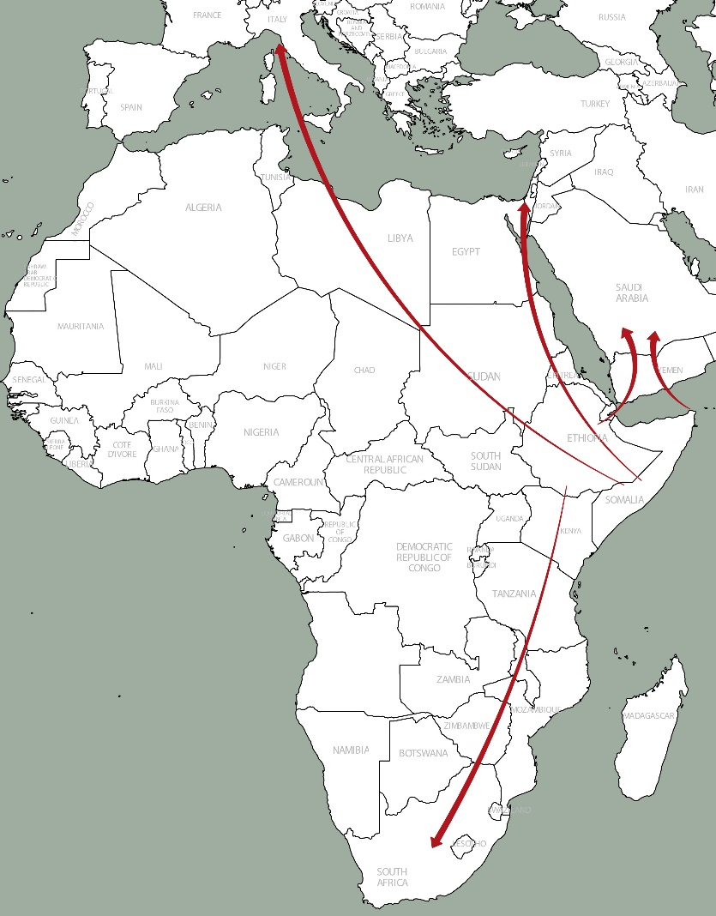
3 MAIN ROUTES
Eastern route
Southern route
Northern route
Notes:
A region of origin, transit and destination
Major nationalities – ER, ET, SO

Slide 5
INTRA-REGIONAL
832,000
IOM DTM, 2018
Notes:
More than 832,000 on the move in the region in 2018
329,000 Jan-Jul 2019

Slide 6
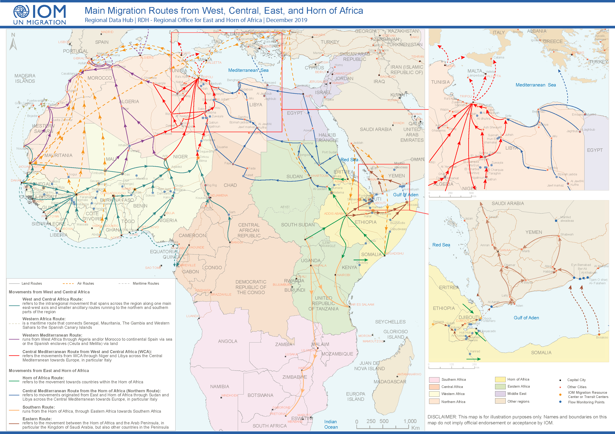
EASTERN ROUTE
138,213
340,000
IOM, 2019
Notes:
11,000 per month
men 72%, women 18%
Ethiopians 92%
KSA 88%, YE 12%
BOS 62%, OBK 38%
1,000 crossing into Saudi every day

Slide 7
SOUTHERN ROUTE
13-14,000
RMMS, 2017
Notes:
80% SO, 20% ET

Slide 8
NORTHERN ROUTE
from 22%
to <1%
UNHCR
Notes:
Arrivals in Italy
22% end 2016 v <1% end 2019
Eritreans – surge after opening of borders with Sudan/Ethiopia
80% intend to move on from Ethiopia

Slide 9
THE CONTEXT
Endemic poverty
Conflict
Youth bulge
Persecution
Urbanisation
Drought
Mass deportations

Slide 10
DRIVERS OF MIGRATION
24%
24%
23%
ECONOMIC
LACK OF RIGHTS
VIOLENCE
Unemployment
Not earning enough
No access to credit
Freedom of expression
Political persecution
Ethnic discrimination
General insecurity
Political unrest
Civil war
Notes:
Interviews with more than 2,500 respondents, 2017-2019
Lesser extent – Lack of services (14%); personal (9%); environment or
71% give more than one reason, only 29% give single factor
By nationality
Eritreans – lack of rights
Ethiopians – lack of rights; economic and violence
Somalia – economic and violence
Yemen – violence

Slide 11
TRENDS
more complex (multiple drivers)
more mixed (regular, irregular, forced, economic)
more versatile (routes and methods change fast)
less protected (rising vulnerability)
more exploited (not just by criminals also state officials)
growing in number (and independent of specific crises)
less tolerated (securitization)

Slide 12
RECONCILING DIFFERENT PERSPECTIVES
Countries of origin (protect citizens, remittances, alleviate pressure on labour market)
Countries of transit (economy boost)
Countries of destination (control migration)
The role of protection?

Slide 13

www.mixedmigration.org

