Slide 1

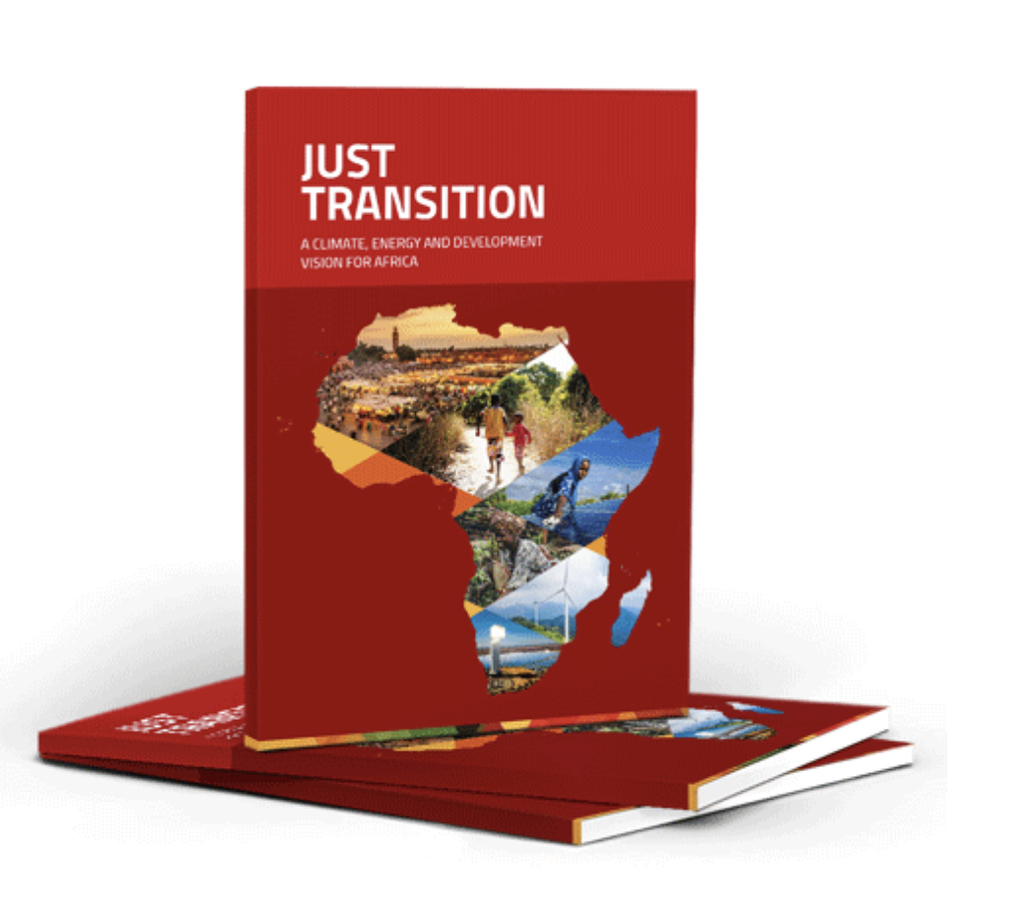
JustTransitionAfrica.org
The independent expert group on
Just Transition and Development

Slide 2
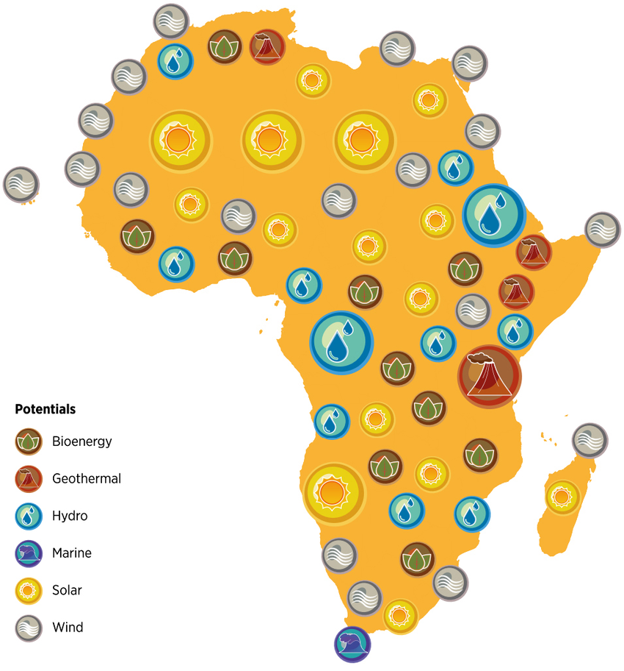
…potential
Current primary energy consumption = 157,000 TWh = 14,000 Mtoe = 567EJ
14,000+ GW potential; Actual capacity 48 GW (all combined)

Slide 3
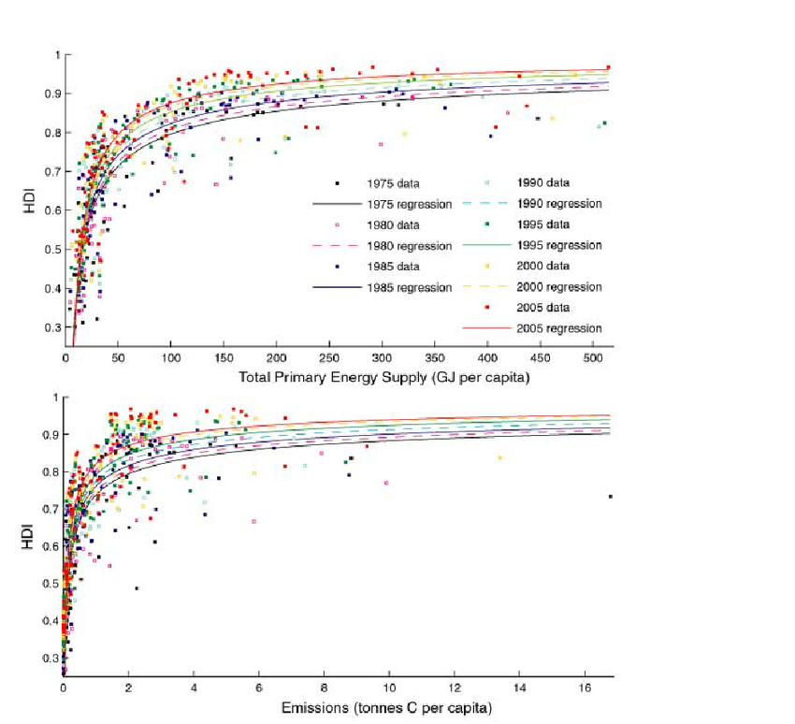
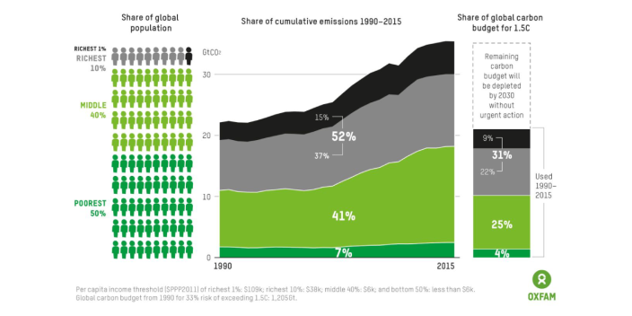
HDI, energy use and carbon emissions
Global inequality of carbon emissions
Is emissions reduction Africa’s agenda?

Slide 4
An African Long-term Strategic Vision
“If we don’t have a long-term strategic vision for ourselves, we’ll continue to be part of someone else’s strategic vision.”
Africa cannot continue to play the role of:
  Source of cheap raw materials,
  Damping ground for Global North industrial output,
  Low-cost tourism destinations, and
  Damping ground for obsolete assembly-line manufacturing.

Slide 5
Africa’s Structural Economic Deficiencies: …
High external debt (borrowing costs 8x)
Major root causes:
  Energy deficit
  Food deficit
  Low value-added industrialization
Trade deficits
  → Currency devaluation
  → Food & Fuel price inflation
  → Social Unrest unless Food/Fuel subsidies are maintained (forces the country to continue to borrow from foreign lenders: bandaid solution)

Slide 6
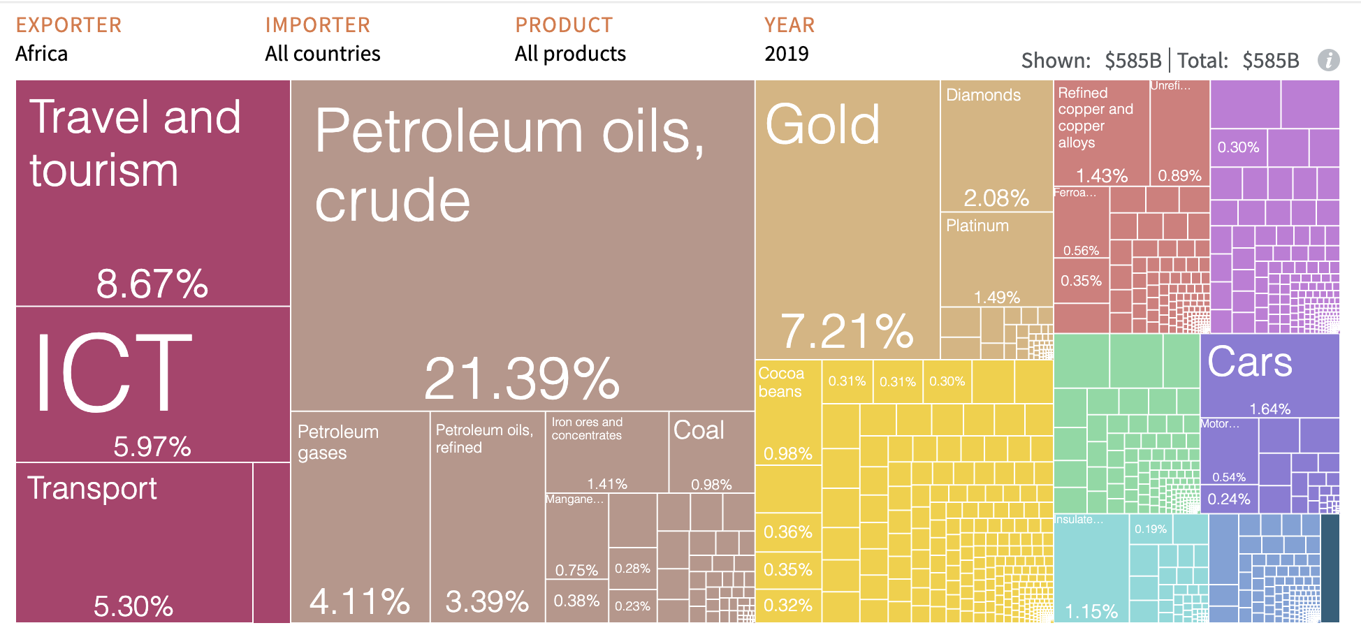

Africa’s Exports
Source: https://atlas.cid.harvard.edu/

Slide 7
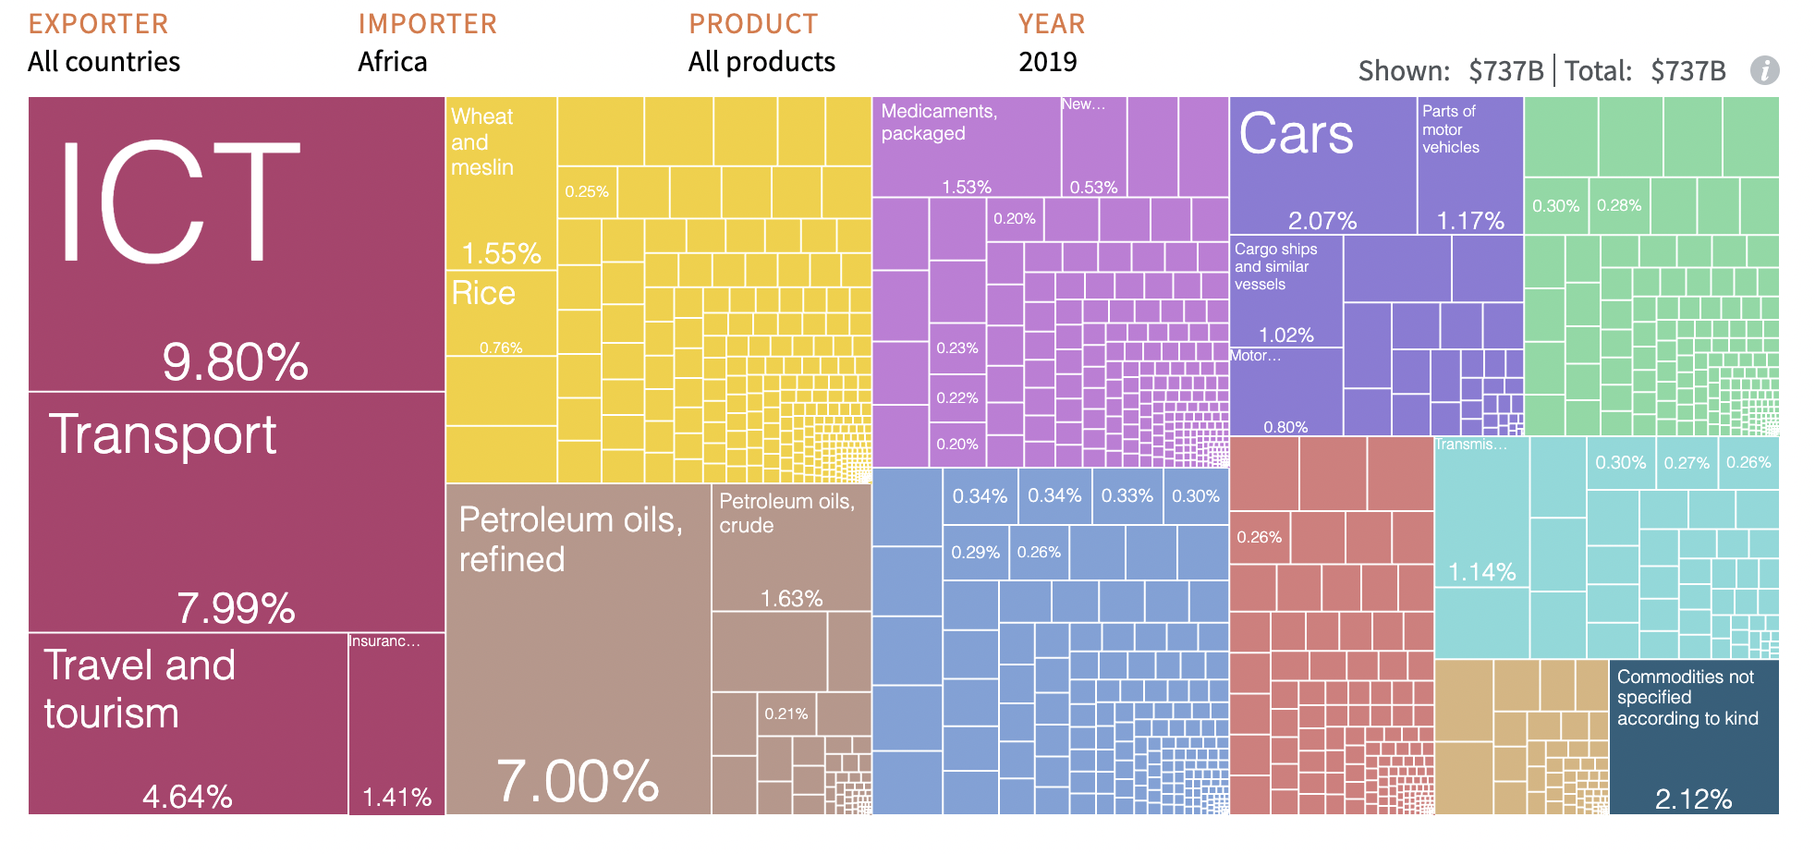
Africa’s Imports
Source: https://atlas.cid.harvard.edu/

Slide 8
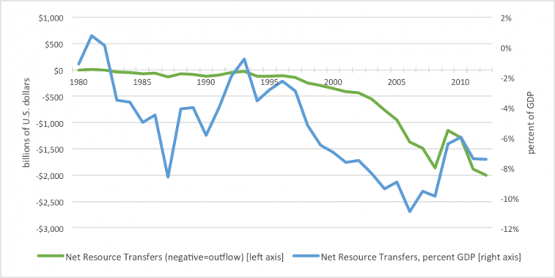
Neocolonial Net Wealth Extraction
Source: Global Financial Integrity

Slide 9
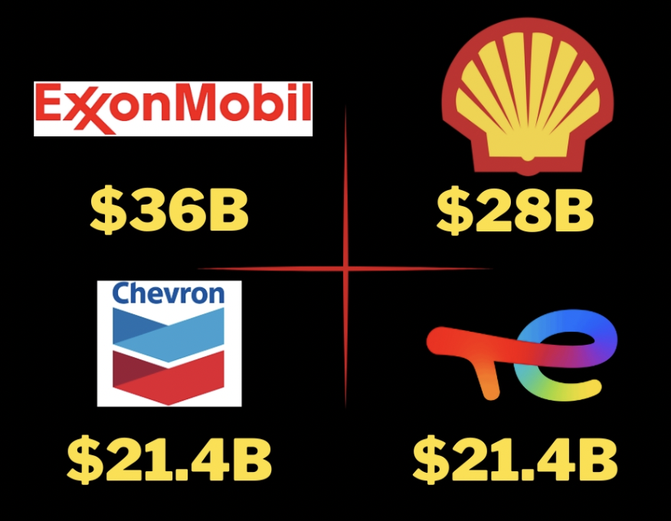
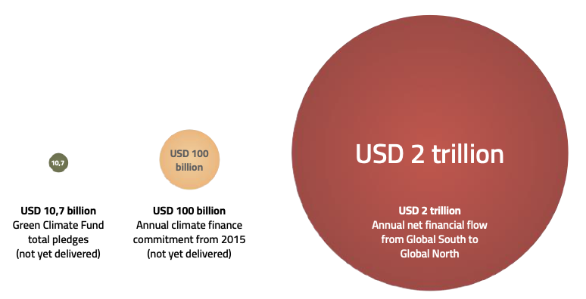
The result is net neocolonial wealth extraction of over $2 trillion from the Global South to Global North every year
.
USD 0.7 billion
Loss & Damage Fund
Source: Global Financial Integrity

Slide 10
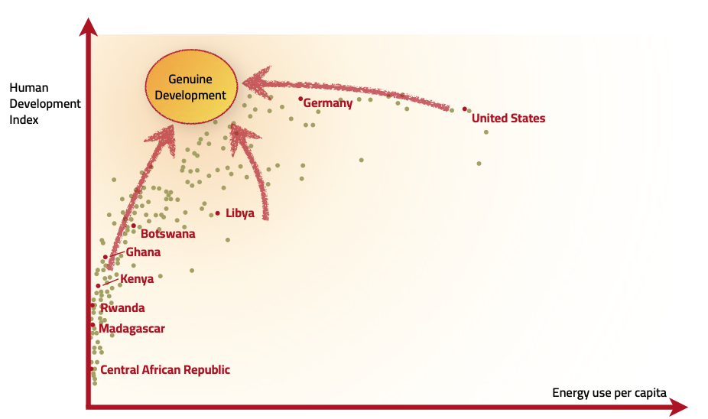
Report highlights several key principles:
African ownership and agency in energy initiatives and plans
Integrating energy systems design into wider development objectives and planning
Provide scope for the delivery of energy as a common good and to genuinely foster energy democratisation
Ensuring stakeholder participation, equity and sufficiency in terms of energy use
No truly “developed” countries – all need to change to achieve sustainable prosperity
A just energy transition must also ensure the right choices about renewable energy

Slide 11

Mainstream Climate Finance:
No reparations, no grants
Concessional loans
De-risking for foreign investors
Pollution Permits (a.k.a. Carbon Credits)
Green energy extractivism
Decarbonization by dispossession

Slide 12
Structural Solutions:
Pan-African/GS Cooperation for strategic investments in:
  Food Sovereignty and agroecology (not “food security”)
  Renewable Energy Sovereignty (not renewable energy exports)
  High value-added industrial policies
    Renewables infrastructure
    Clean cooking infrastructure
    Green transportation

Slide 13
Structural Solutions:
Scaling up finance through existing mechanisms
Structural transformation of the Global Financial Architecture
Deploying innovative financial sources such as redirection of harmful subsidies and special drawing rights (SDRs) allocations
Build strategic and long-term partnerships

Slide 14
Just Transition
A Climate, Energy, and Development Vision for Africa
Yacob Mulugetta
Science, Technology, Engineering & Public Policy (STEaPP)
University College London (UCL)
Yacob.mulugetta@ucl.ac.uk
Africa’s Struggle for Climate Justice
VIDC
March 21, 2024

